Slide 1


TEAM 2
CSE411
Power window control system

Slide 2

CONTENT
01
TEAM ROLES
02
PROJECT DESCRIPTION
03
STATE DIAGRAM
04
CIRCUIT TOPOLOGY
05
HANDLING CORNER CASES

Slide 3





TEAM ROLES
Marc
Nagy
Youssef
Ashraf
Philopateer Samuel
Marcous
Wael
Windows movement up +Emergency
Driver control
Driver Lock
Driver motor
Hardware
Passenger control
Initialization
Windows movement
down

Slide 4

PROJECT DESCRIPTION
This project is written in C to control a window motor using tasks controlled by FreeRTOS and is designed to be executed on an embedded system. The code defines several tasks and uses semaphores, mutex locks, and queues for synchronization between these tasks.

Slide 5
STRUCTURE
Application
HAL
MCAL

Slide 6

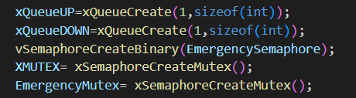
INTIALIZATION
In the beginning of the main we start by initializing the needed queues, semaphores, and mutex locks.

Slide 7
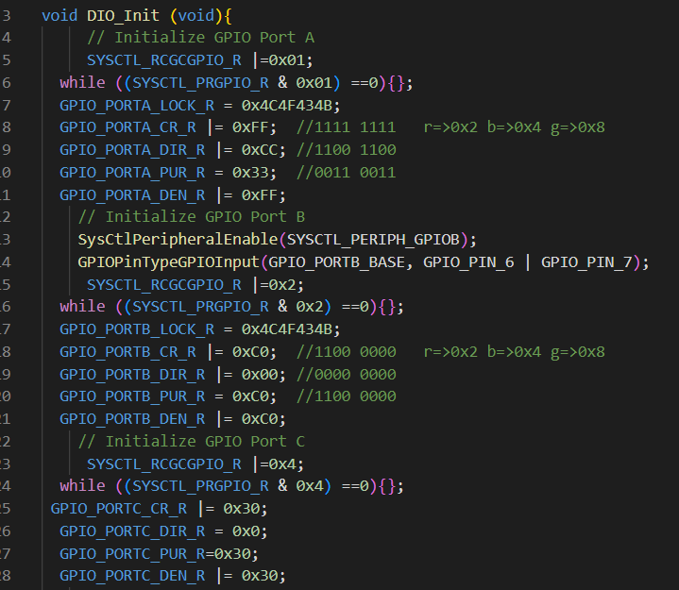
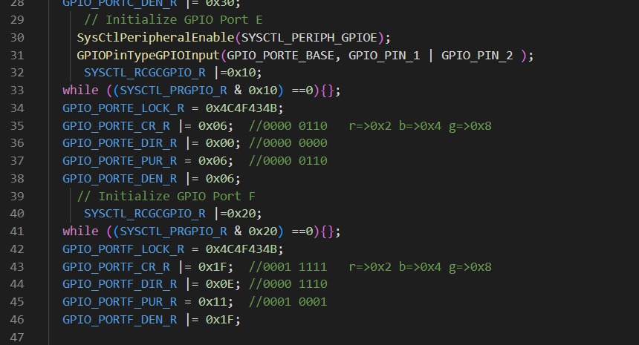
INTIALIZATION
Then we call DIO_INIT to initialize
the ports needed for the buttons
and switches in the DIO.C file.

Slide 8
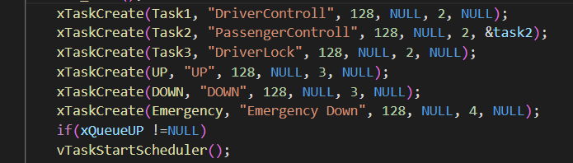
SCHEDULER
Lastly, we create the tasks and
start the scheduler

Slide 9
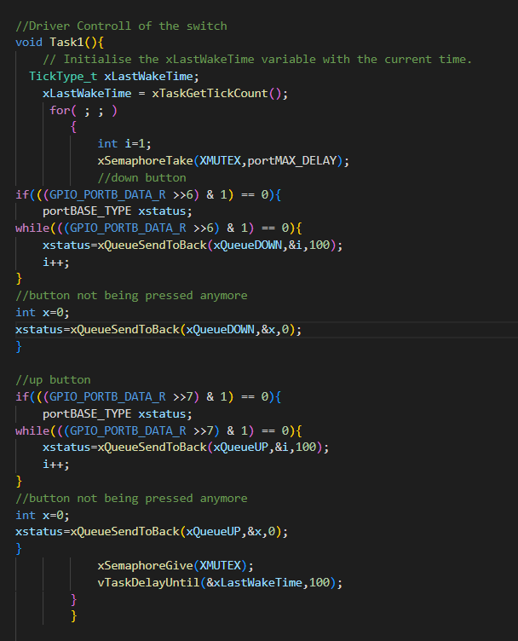
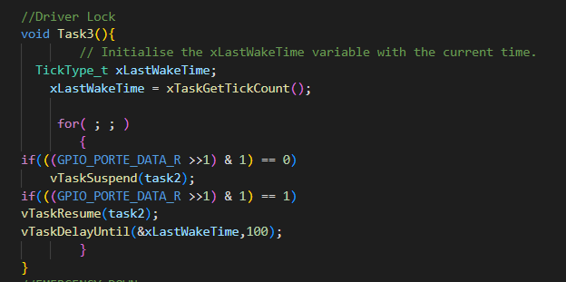
DRIVER CONTROL

Slide 10
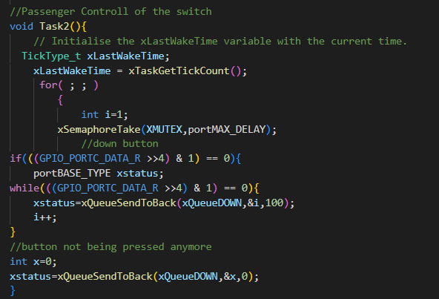
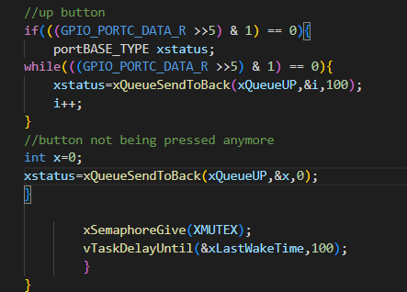
PASSENGER CONTROL

Slide 11
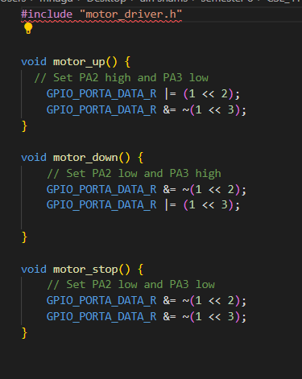
MOTOR DRIVER
This is the motor driver used to
make the motor rotate clockwise
and anti-clockwise to move the
window

Slide 12
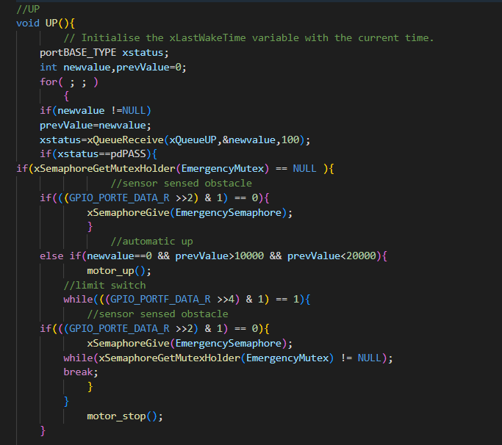
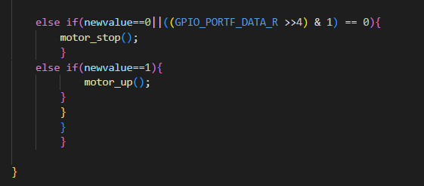
WINDOWS MOVEMENT UP

Slide 13
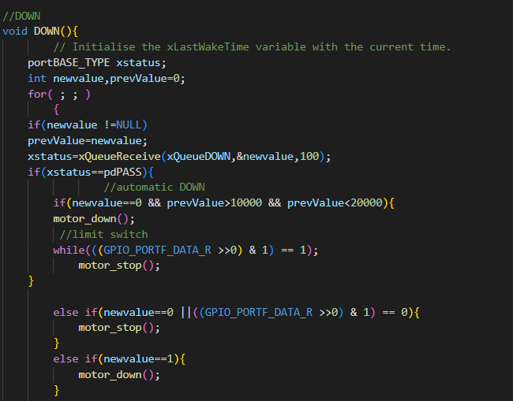
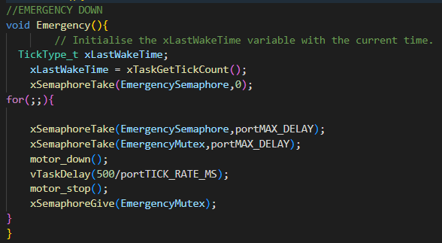
WINDOWS MOVEMENT DOWN

Slide 14
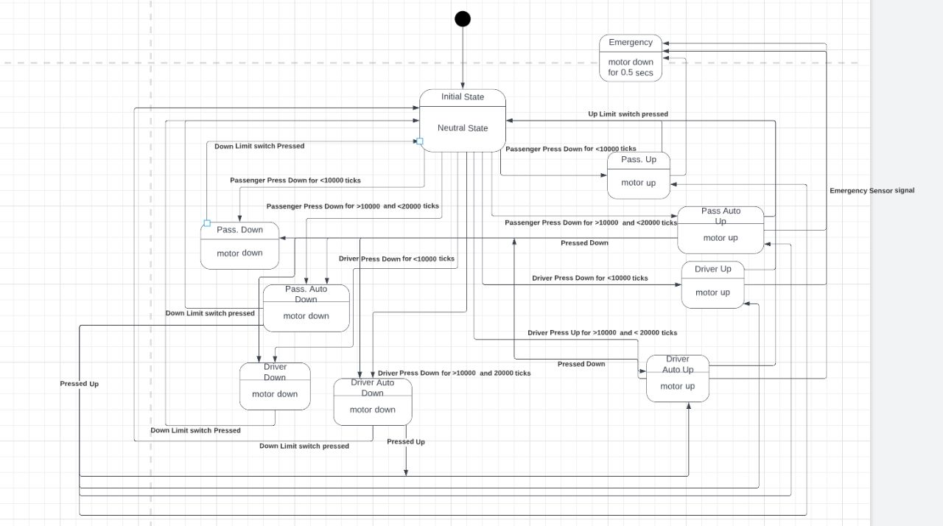
STATE DIAGRAM

Slide 15
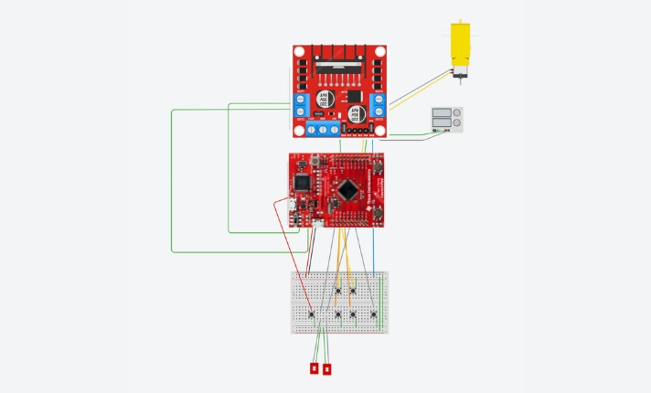
Circuit Topology

Slide 16
HANDLING CORNER CASES
Notes:
Driver and passengenr pressing up and down at the same time
Auto up or down and wants to stop it
Jamming
Limit sw up and down with auto
Limit sw up and down manual
Driver lock and test pass not working and driver working
Auto up and limit sw down

Slide 17

THANK'S FOR WATCHING
ANY QUESTION?
TEAM 2

